Slide 1




Presented By:- Group No.6 1. Apurva Salunkhe 2. Rachana Ketkar 3. Amol Patil 4. Aarthi Vikraman 5.Maitri Kulkarni 6. Jayesh Gurav 7. Naveen H
BANK LOAN OF CUSTOMERS

Slide 2
Index:
Introduction about Bank & Loan Process
List of KPI ‘s
Dashboard
Challenges
KPI Outcome

Slide 3

Introduction about Bank
Bank is a financial institution provides many services like CASA Accounts , Fixed Deposits, Locker facilities, Loan
One of the primary services offered by banks is the provision of loans to customers, and facilizing their aspirations and financial needs.
Dataset
To bring the final output, we have used a Bank set of Finance 1 and Finance 2 sheet having the data from the year 2007 to 2016 with 24 -25 columns.
It allows you to have multiple dimension from each Bank data set: Year wise loan Amount, Grade and sub grade wise revol bal, Total payment of Verification status wise , State wise and last Credit pull_d wise status, Home ownership Vs Last payment status.
Additional Dimension: Percentage of loan amount VS purpose, Count of members by states.

Slide 4
List of KPI’s
KPI 1- Year wise Loan Amount Stat
KPI 2- Grade & Sub-grade wise Revolving Balance
KPI 3 – Verification status by Total Payments
KPI 4- State wise and Last_Credit_Pull Date wise Status
KPI 5- Home Ownership Vs Last payment date
KPI 6- Purpose of Loan amount
KPI 7 – Count of Members by States

Slide 5
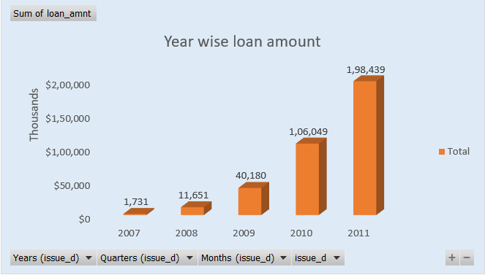
KPI-1
Yearwise loan amount" in banking terms refers to the representation or analysis of loan amounts based on the years in which the loans were originated or disbursed. This type of analysis provides insights into the historical distribution of loan amounts over different years, helping financial institutions, analysts, and stakeholders understand trends and patterns in lending activity.
Over the year from 2007 to 2011 loan amount disbursed was increased showing 1731 to 198439

Slide 6
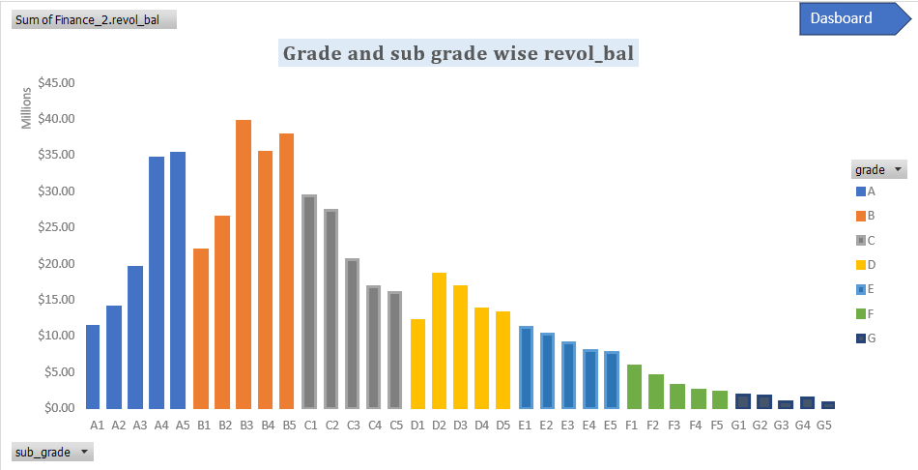
kpi-2
In banking, grades and subgrades, often denoted by letters and numbers, are used to categorize the credit quality of borrowers. For example, a credit grade might be assigned as 'A' and further broken down into subgrades like 'A1,' 'A2,' etc.
These classifications provide insights into the creditworthiness of borrowers. Generally, higher grades and subgrades indicate lower credit risk, suggesting that the borrower is more likely to meet their financial obligations.In the context of revolving balances, the credit grade and subgrade can influence factors such as interest rates and credit limits.
Borrowers with higher credit grades may be eligible for lower interest rates and higher credit limits, reflecting a lower perceived risk by the bank. Conversely, lower credit grades may result in higher interest rates and lower credit limits, as the bank seeks to compensate for the higher risk associated with those borrowers.Understanding credit grades and subgrades helps banks make informed lending decisions, tailor terms to risk levels, and manage their overall credit risk exposure.

Slide 7
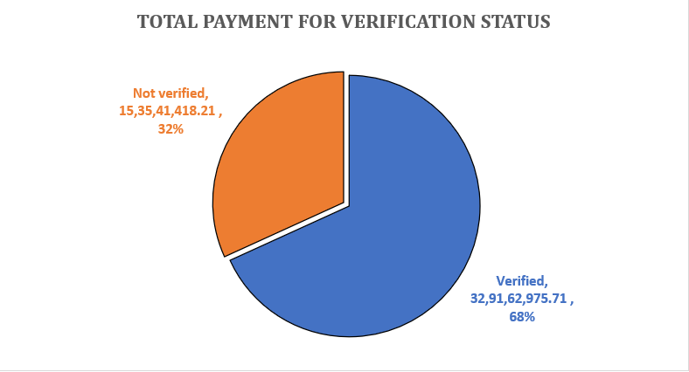
Kpi-3
Lenders use the verification process as part of their risk assessment. The more thoroughly the borrower's financial information is verified, the lower the perceived risk for the lender.Verified and source-verified statuses provide lenders with a higher level of confidence in the borrower's ability to repay the loan, which may result in more favorable loan terms and higher loan amounts
.Documentation Requirements:Borrowers in a verified or source-verified status typically need to provide supporting documentation, such as bank statements, pay stubs, tax returns, and other financial records.
Non-verified status may involve less documentation, but this may come at the expense of higher interest rates, lower loan amounts, or additional scrutiny.In summary, the relationship between verified status, non-verified status, source-verified status, and loan amount is tied to the lender's confidence in the accuracy of the borrower's financial information.
Borrowers with verified or source-verified status generally have a better chance of qualifying for higher loan amounts due to the increased credibility of their financial profile. Non-verified status, on the other hand, may result in more conservative lending decisions.

Slide 8
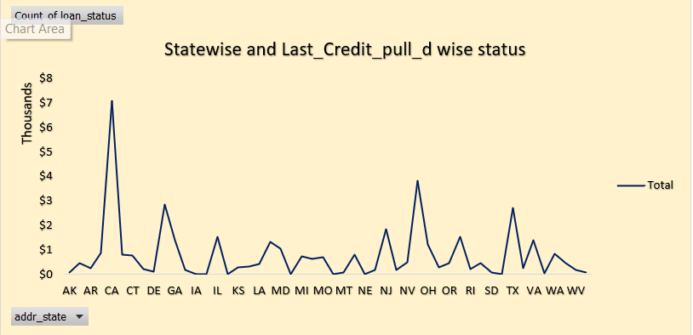
Kpi-4
Analyzing state-wise last credit pull date-wise loan status in banking terms can provide valuable insights into the credit behavior and loan performance across different regions. By examining the distribution of loan statuses such as approved, pending, rejected, or defaulted, along with the corresponding last credit pull dates, financial institutions can identify patterns and trends indicative of creditworthiness, risk levels, and economic conditions within each state.
observing a higher frequency of loan approvals coinciding with recent credit pull dates may suggest a proactive approach by borrowers in maintaining their credit profiles or a positive economic environment conducive to borrowing. Conversely, a concentration of rejected or defaulted loans paired with outdated credit pull dates could signal potential credit challenges or economic hardships prevalent in certain regions.
Overall, leveraging state-wise last credit pull date-wise loan status data empowers financial institutions to make informed decisions regarding credit underwriting, portfolio management, and resource allocation, ultimately contributing to enhanced risk assessment, regulatory compliance, and customer satisfaction within the banking sector

Slide 9
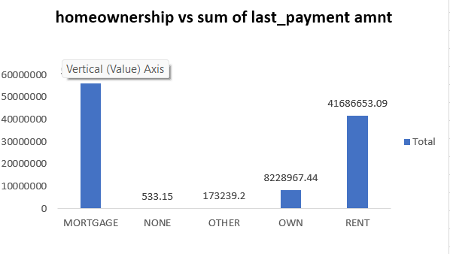
Kpi-5
Home ownership" refers to the status of owning a property, typically through a mortgage or outright purchase.When you own a home, you have legal rights to the property, and you may build equity over time as you make mortgage payments.
Last Payment Date:The "last payment date" is the date on which the borrower made the most recent payment on their mortgage.This date is important for tracking the payment history of the loan and understanding the current status of payments.
The relationship between these two concepts lies in the progression of home ownership through the repayment of a mortgage As a borrower makes monthly mortgage payments, they reduce the outstanding balance on the loan. Over time, these payments contribute to building equity in the property. The "last payment date" is relevant because it indicates when the borrower made the most recent payment, which is essential for staying current on the loan and avoiding late fees or other penalties.

Slide 10
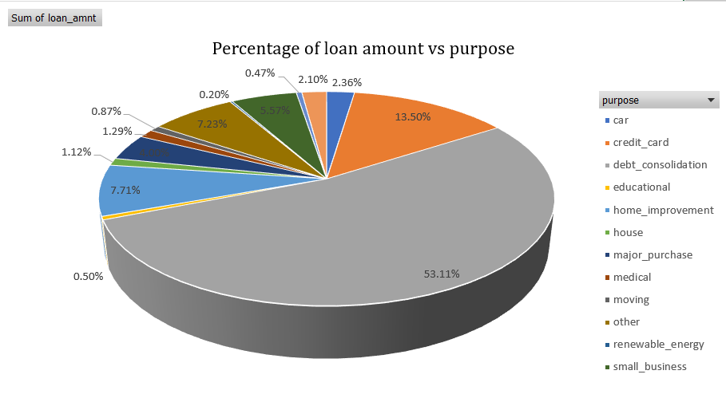
Kpi-6
The main purpose of member or customer to apply loan was debt consolidation,contributing 53.11% comparing to all other .

Slide 11
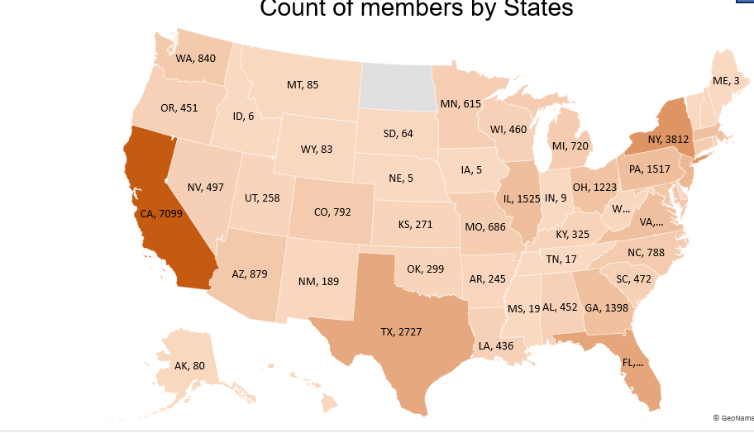
KPI-7
By analysing this kpi we can say that bank has received more loan application from the state like CA,NY,TX,FL as compared to other state and less application was observed from states like IA,ID,IN..

Slide 12
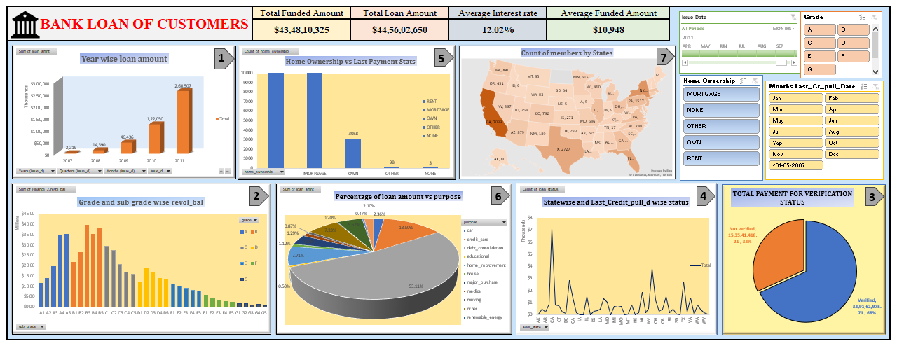
Dashboard- Excel

Slide 13
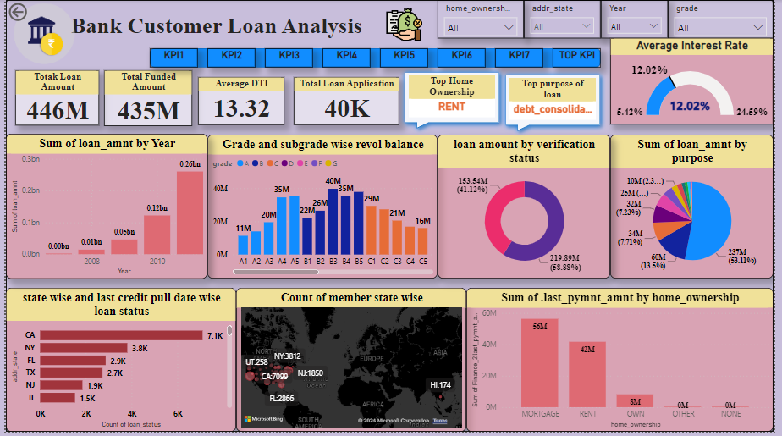
Dashboard- Power Bi

Slide 14
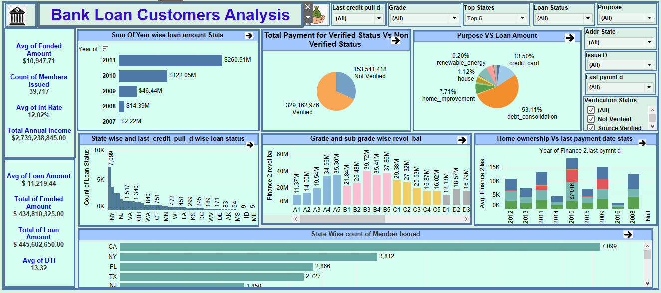
Dashboard-Tableau

Slide 15
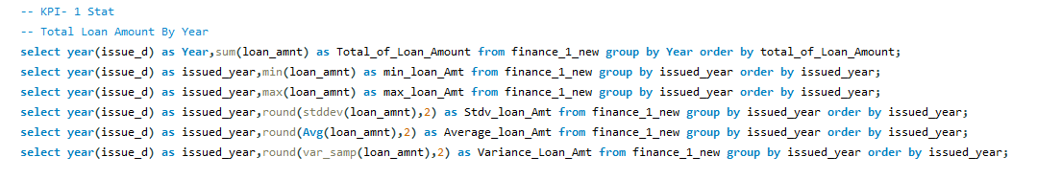
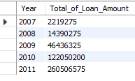
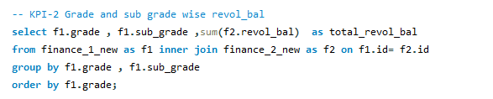
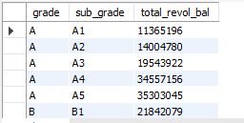
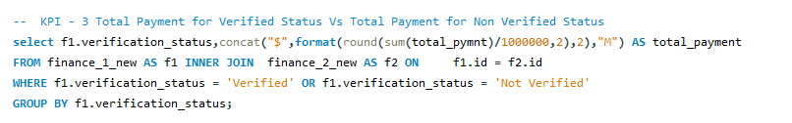

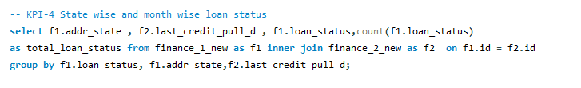
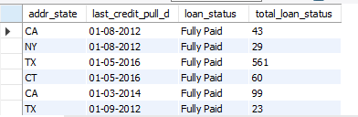
Dashboard- SQL

Slide 16
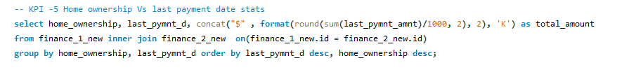
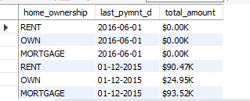

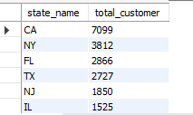
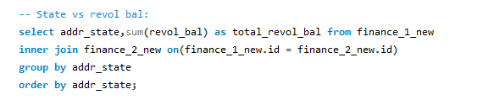
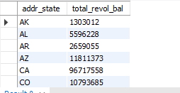
Dashboard- SQL

Slide 17
Challenges
Null Value
Duplicate values
Merging Datasets of different formats
Column Formatting

Slide 18
KPI Outcome
From overall outcome and comparing with other Grades, we could see a huge Loan Amount of $13,36,51,350 has been processed from Grade B.
The purpose of availing loan is because of Debt consolidation which has 53.11%.
In the month of May from the year 2011, the customer has applied for Loan amount from the state CA having 7099 customers count.
Customer belongs to Other Home ownership have more Not verified status as 40%.
Customer belongs to Mortgage Home ownership have more Verified status as 72%.
With maximum amount of 35K loan amount, we could see count of 517 customers has availed with 60 months of term while comparing to the customers count with the term of 30 months term.

Slide 19
Project Conclusion
Loan Performance The loan performance page provides a detailed analysis of the bank's loan portfolio. It includes visualizations that show the loan status distribution by loan amount, borrower's credit score, and loan type. The visualizations on this page help the bank managers to identify the loans that are performing well and the loans that are at risk of default.
Borrower Analysis The borrower analysis page provides insights into the borrowers who have taken loans from the bank. It includes visualizations that show the borrower's age distribution, income distribution, and credit score distribution. The visualizations on this page help the bank managers to identify the target customer segments and design loan products that cater to their needs.
Loan Application Analysis The loan application analysis page provides insights into the loan application process. It includes visualizations that show the loan application volume by month, loan application status distribution, and loan application rejection reasons. The visualizations on this page help the bank managers to identify the bottlenecks in the loan application process and optimize the loan approval process.
Conclusion This Power BI project provides a comprehensive view of the bank's loan portfolio and helps the bank managers to analyze the loan data and make informed decisions. The visualizations on each page provide insights into various aspects of the loan portfolio, and the dashboard as a whole provides a holistic view of the loan portfolio.

